Slide 1
Predicting performance of online media content
Capstone Project II by Liudmila Khalitova
Supervisor Varun Bhatia
Springboard 2020

Slide 2
PROBLEM STATEMENT
AUDIENCEINTEREST
EDITORIAL DECISIONS
Drives editorial decisions regarding what gets published
Editors and reporters receive dozens of corporate press-releases each day. Only a tiny fraction of them receives coverage
PUBLIC RELATIONS CONTENT
Corporations compete for media and audience attention
Public relations practitioners have always been looking for ways to increase positive media attention to their organizations. One common practice includes media pitching and distribution of a company's news to journalists and media outlets via press releases. While public relations managers get to decide what kind of news their company will be sharing with media, journalists and editors are the gatekeepers deciding whether the audience of their outlets will actually see that news. Relevance and audience interest in a particular topic are one of the common factors that media professionals take into account when making editorial decisions. If a corporation's public relations department knows exactly what kind of their corporate news generate the most interest among media audiences, they would be able to pitch outlets more successfully by addressing the topics that attract readers the most.

Slide 3
Defining audience interest in online news content
You can edit this text. Edit this line of text. You can edit this text.
UNIQUE VISITORS
The number of people who have seen an online article
IMPRESSIONS
The number of times an article was viewed
LIFESPAN
The number of days an article continues to drive views and visits without a significant decline

Slide 4
RESEARCH QUESTIONS
What topics drive media attention toward organization?
Does audience interest in a news media article depend on the article’s topic?
Does an article’s lifespan depend on its topic?

Slide 5
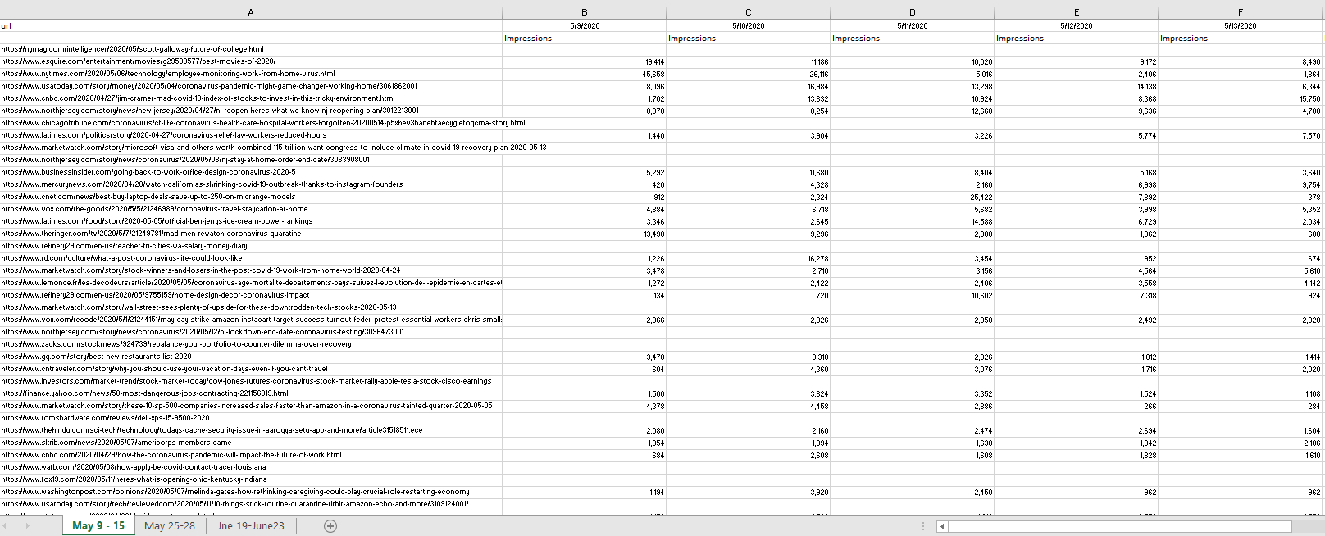
The dataset
The original data set represented an Excel file exported from the Cision Impact platform. The file had three sheets with date ranges: May 9-15, 2020, May 25-28, and June 19 through 23 of 2020. Each sheet had a column with URLs, columns with dates and sub-columns with metrics Impressions (how many times an article was viewed) and Unique Users (how many unique users have visited the page) on each day.

Slide 6
The approach
URL PARSING
Extracting article’s keywords from URLs.
KEY WORD EXTRACTION
Determining most important keywords with TF-IDF.
TOPIC MODELING
Grouping keywords into broader topics.
DATA CLEANSING
Preparing data for statistical analysis
STATSITICAL ANALYSES
ANCOVA and article half-life

Slide 7
TOPICS EXTRACTED
You can edit this text. Edit this line of text. You can edit this text.
BUSINESS AND TECHNOLOGY
EMPLOYEE WELLNESS
COVID-19 UPDATES
SPORTS AND COMPETITION
STOCK MARKET NEWS
REMOTE WORK
Notes:
Business and Technology
Sports and Competition
Remote Work
COVID-19 Updates
Employee Wellness
Stock Market Performance

Slide 8
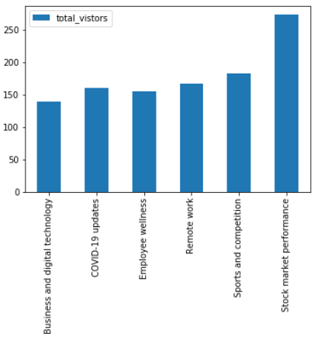
KEY FINDINGS
Business and Technology significantly differed from other topics in terms of their ability to generate impressions. This topic, on average, received 209 views fewer than other topics (p = .028). Pairwise comparisons revealed that in comparison with Remote Work, Business and Technology received 244 fewer views (p = .043); in comparison with COVID-19 Updates it had 255 fewer views (p = .015) and 209 fewer views than Stock Market Performance (p = .028). There were no statistically significant differences between Business and Technology and Sports and Competition and Business and Technology and Employee Wellness.

Slide 9
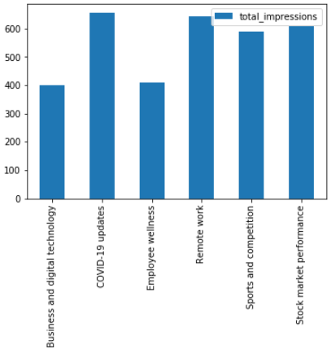
KEY FINDINGS
Stock Market Performance performed significantly better than every other topic in terms of unique visitors. On average, it attracted 92 users more than Sports and Competition (p = .042), 133 users more than Business and Technology (p = .004), 106 users more than Remote Work (p = .033), 113 users more than COVID-19 (p = .018), and 118 users more than Employee Wellness (p = .022).

Slide 10
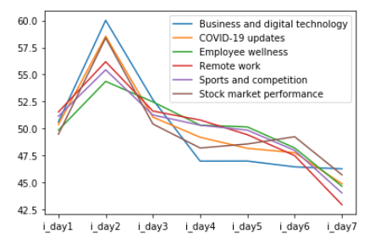
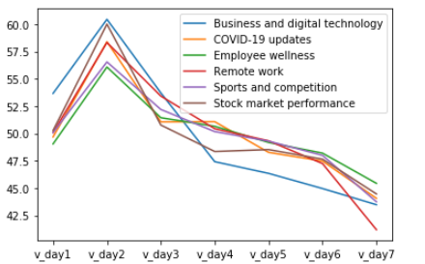
KEY FINDINGS
Both unique visitors and impressions across all topics peak around day 2, remain relatively stable on days 3 to 6, and drop from day 6. The decline for Business and Digital Technology seems to be the most dramatic.

Slide 11
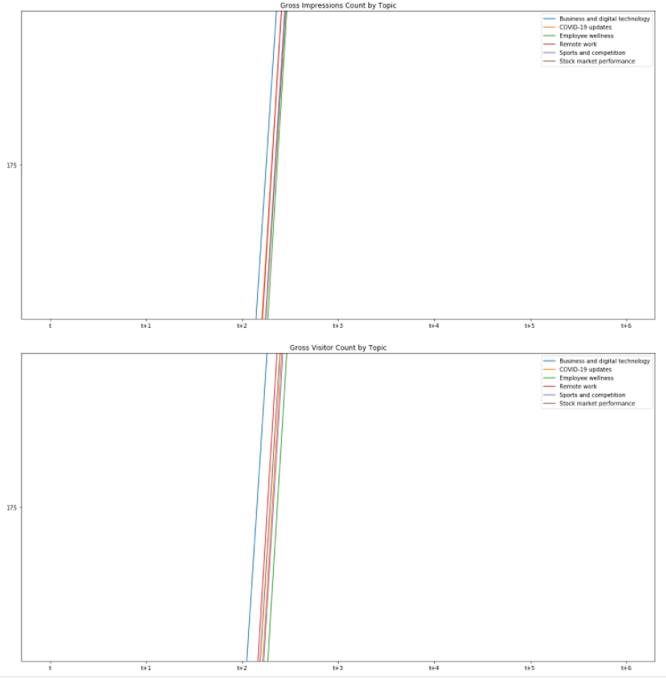
KEY FINDINGS
The charts suggest that regardless of topic, all articles reach their half-life between days 3 (t+2) and 4 (t+3) since their publication (t). while Business and Technology does reach its half-life slightly quicker than other topics, still it remains within the same range as other topics (day 3 to 4). This means that an article's topic did not significantly affect its lifespan, meaning that readers were loosing interest in online content at approximately the same rate across topics

Slide 12
limitations
The dataset used in this study was limited to news media articles mentioning only one company, Service Now. Therefore, the generalizability of the findings presented across companies and industries is unknown. More research needed to confirm our findings regarding of the lifespan of online news content. In addition, I investigated the topics relevant specifically to Service Now, it is not clear how applicable they would be even within the same industry. Finally, some of the extracted topics are specific to the time frame when the data was collected (e.g. May – June 2020), when COVID-19 coverage was especially prominent. Therefore, the topic extraction procedure may need to be repeated for each client if the media landscape significantly changes.

Slide 13
KPI INFOGRAPHICS
500.000
MERCURY
NEPTUNE
Mercury is the closest planet to the Sun
Neptune is the farthest planet from the Sun
250.000
MARS
JUPITER
100.000
Despite being red, Mars is a cold place
It's the biggest planet in the Solar System
22%
34%
46%
68%
Venus has a beautiful name. It’s hot
Saturn is the ringed planet. It’s a gas giant
The Sun is the star at the center
The Moon is a satellite. It orbits Earth

Slide 14
KPI INFOGRAPHICS
60%
10,000
8,000
4,000
10,000
40%
20%
90%
MERCURY
NEPTUNE
70%
Mercury is the closest planet to the Sun
Neptune is the farthest planet from the Sun
50%
30%
MARS
JUPITER
Despite being red, Mars is a cold place
It's the biggest planet in the Solar System

Slide 15
KPI INFOGRAPHICS
Mars
Retail SALES INCREASE
INTERNET SALES INCREASE
Despite being red, Mars is a cold place
neptune
15%
22%
Neptune is the farthest planet from the Sun
11%
26%
Mercury
Mercury is the closest planet to the Sun
18%
20%
SATURN
90%
85%
36%
45%
It’s composed of hydrogen and also of helium
70%
60%

Slide 16
KPI INFOGRAPHICS
MERCURY
NEPTUNE
VENUS
Mercury is the closest planet to the Sun
Neptune is the farthest planet from the Sun
Venus has a beautiful name, but It's very hot
01
02
03
04
05
MARS
JUPITER
Despite being red, Mars is a cold place
It's the biggest planet in the Solar System
50%
60%
40%
80%
90%

Slide 17
KPI INFOGRAPHICS
% SALES
% NEW CUSTOMERS
% GOALS
25%
48%
78%
20%
30%
Mars
neptune
Mercury
40%
Despite being red Mars is a cold place
Neptune is the farthest planet from the Sun
Mercury is the closest planet to the Sun

Slide 18
KPI INFOGRAPHICS
4
2019 | 2020
500 Units | 200 Units
1600 Units | 1300 Units
1000 Units | 1400 Units
2300 Units | 2600 Units
2700 Units | 3100 Units
3300 Units | 3900 Units
1
3
2
MERCURY
NEPTUNE
Mercury is the closest planet to the Sun
Neptune is the farthest planet from the Sun
MARS
JUPITER
Despite being red, Mars is a cold place
It's the biggest planet in the Solar System

Slide 19
KPI INFOGRAPHICS
50%
20%
30%
Mars
neptune
SATURN
40%
35%
Despite being red, Mars is a cold place
Neptune is the farthest planet from the Sun
It’s composed of hydrogen and helium
70%
80%

Slide 20
KPI INFOGRAPHICS
21%
28%
30%
39%
34%
MERCURY
VENUS
JUPITER
SATURN
Mercury is the closest planet to the Sun
Venus is the second planet from the Sun
Jupiter is the biggest planet of them all
Saturn is the ringed one and a gas giant

Slide 21
KPI INFOGRAPHICS
VENUS
Venus has a beautiful name and is the second one from the Sun
8,700
MERCURY
Mercury is the closest planet to the Sun and the smallest one
5,200
MARS
Despite being red, Mars is a cold place full of iron oxide dust
4,100
JUPITER
Jupiter is a gas giant and the biggest planet of all of them
7,600
40%
50%
70%
80%

Slide 22
KPI INFOGRAPHICS
20%
40%
30%
60%
50%
JAN
FEB
MAR
APR
MAY
JUN
JUL
AUG
SEP
OCT
NOV
DEC
80%
MERCURY
SATURN
JUPITER
Mercury is the closest planet to the Sun
It’s the only one with rings of all of them
It's the biggest one in the Solar System
MARS
NEPTUNE
VENUS
Despite being red, Mars is a cold place
It’s the farthest one from the Sun
Venus has a beautiful name but It's very hot

Slide 23
KPI INFOGRAPHICS
Jan
Feb
Mar
Apr
May
Jun
Jul
Aug
Sep
Oct
Nov
Dec
2018
2019
2020
2021
20%
40%
60%
80%
Mercury is the closest planet to the Sun
Venus is the second planet from the Sun
Jupiter is the biggest planet of them all
Saturn is the ringed one and a gas giant

Slide 24
KPI INFOGRAPHICS
Mercury
saturn
Mercury is the closest planet to the Sun
It’s composed of hydrogen and helium
Mars
neptune
Despite being red, Mars is a cold place
Neptune is the farthest planet from the Sun
20%
60%
40%
80%

Slide 25
KPI INFOGRAPHICS
Mercury
saturn
Mercury is the closest planet to the Sun and the smallest one
It’s composed of hydrogen and helium and it has rings
Mars
neptune
Despite being red, Mars is actually a cold place full of iron dust
Planet Neptune is the farthest planet from the Sun of all of them
20%
40%
60%
80%

Slide 26
KPI INFOGRAPHICS
A
B
C
D
A
B
C
D
A
B
C
D
Mercury
Mercury is also the closest planet to the Sun
Mars
Despite being red, Mars is a cold place
SATURN
It’s composed of hydrogen and also of helium
VENUS
Venus has a beautiful name but It's terrible hot

Slide 27
KPI INFOGRAPHICS
Mercury
saturn
venus
40%
40%
80%
Mercury is the closest planet to the Sun
It’s composed of hydrogen and of helium
Venus has a beautiful name but It's very hot
Mars
neptune
jupiter
60%
60%
70%
Despite being red, Mars is a cold place
Neptune is the farthest planet from the Sun
It's the biggest planet in the Solar System
100,000
$100,000.00

Slide 28
KPI INFOGRAPHICS
A
18%
MERCURY
B
C
92%
MARS
D
83%
saTURN
MERCURY
SATURN
Mercury is the closest planet to the Sun
It’s composed of hydrogen and of helium
MARS
NEPTUNE
77%
NEPTUNE
Despite being red, Mars is a cold place
Neptune is the farthest planet from the Sun
100,000
$100,000.00

Slide 29
KPI INFOGRAPHICS
% SALES
% NEW CUSTOMERS
% GOALS
% average
55%
74%
67%
89%
Mars
SATURN
Despite being red, Mars is a cold place
It’s composed of hydrogen and helium
MERCURY
VENUS
Mercury is the closest planet
Venus has a beautiful name
100,000
$100,000.00

Slide 30
KPI INFOGRAPHICS
MERCURY
Mercury is the closest planet to the Sun
MARS
Despite being red, Mars is a cold place
SATURN
It’s composed of hydrogen and helium
NEPTUNE
It’s the farthest one from the Sun
1
2
3
4
Mercury
Mars
Jupiter
Venus
100,000
$100,000.00

Slide 31
KPI INFOGRAPHICS
NEPTUNE
Jupiter
Neptune is the farthest planet from the Sun
Jupiter is the biggest planet of them all
Saturn
Mars
It’s composed of hydrogen and helium
Despite being red, Mars is actually a cold place
24%
21%
$2,000
16%
$1,000
100,000
$100,000.00

Slide 32
KPI INFOGRAPHICS
50
40
30
20
10
75%
50%
25%
0%
25%
50%
75%
MERCURY
Mercury is the closest planet to the Sun and the smallest one
MARS
Despite being red, Mars is a cold place full of iron oxide dust
40%
70%
30%
JUPITER
Jupiter is a gas giant and the biggest planet of all of them
A
B
C
D
E
F
2023
2024
2025
100,000
$100,000.00

Slide 33
KPI INFOGRAPHICS
75%
100%
50%
25%
% SALES
% NEW CUSTOMERS
% GOALS
% average
+12
+24
+39
+33
MERCURY
SATURN
MARS
VENUS
Mercury is the closest planet to the Sun
Saturn is a gas giant and has several rings
Despite being red, Mars is a cold place
Venus is the second planet from the Sun
100,000
$100,000.00

Slide 34
KPI INFOGRAPHICS
Mercury
saturn
Mercury is the closest planet to the Sun
It’s composed of hydrogen and helium
Mars
neptune
Despite being red, Mars is a cold place
Neptune is the farthest planet from the Sun
60%
18%
26%
70%
MERCURY
MARS
SATURN
NEPTUNE
0
10
15
20
25
30
100,000
$100,000.00

Slide 35
KPI INFOGRAPHICS
Venus
50%
Mars
Venus has a beautiful name and is the second one
Despite being red, Mars is also a cold place
35%
10%
Mercury
Jupiter
Mercury is the closest planet to the Sun
15%
Jupiter is a gas giant and the biggest planet
20%
30%
40%
50%
100,000
$100,000.00

Slide 36
KPI INFOGRAPHICS
Venus
Mars
Saturn
90%
70%
40%
75%
80%
60%
60%
85%
100%
2020
2021
2022
Venus is the second planet from Sun
Mars is a cold place full of iron oxide dust
Saturn is a gas giant and has several rings
100,000
$100,000.00

Slide 37
KPI INFOGRAPHICS
MERCURY
Saturn
JUPITER
20%
40%
60%
MARS
NEPTUNE
VENUS
10%
30%
50%
MERCURY
SATURN
JUPITER
Mercury is the closest planet to the Sun
It’s composed of hydrogen and of helium
It's the biggest planet in the Solar System
MARS
NEPTUNE
VENUS
Despite being red, Mars is a cold place
Neptune is the farthest planet from the Sun
Venus has a beautiful name but It's very hot
100,000
$100,000.00

Slide 38
KPI INFOGRAPHICS
VENUS
Venus has a beautiful name and is the second one from the Sun
500
MERCURY
Mercury is the closest planet to the Sun and the smallest one
400
300
MARS
Despite being red, Mars is a cold place full of iron oxide dust
200
100
JUPITER
Jupiter is a gas giant and the biggest planet of all of them
Item 1
Item 2
Item 3
Item 4
100,000
$100,000.00

Slide 39
Instructions for use
In order to use this template, you must credit Slidesgo and Freepik in your final presentation and include links to both websites.
You are allowed to:
- Modify this template.
- Use it for both personal and commercial projects.
You are not allowed to:
- Sublicense, sell or rent any of Slidesgo Content (or a modified version of Slidesgo Content).
- Distribute Slidesgo Content unless it has been expressly authorized by Slidesgo.
- Include Slidesgo Content in an online or offline database or file.
- Offer Slidesgo templates (or modified versions of Slidesgo templates) for download.
- Acquire the copyright of Slidesgo Content.
For more information about editing slides, please read our FAQs or visit Slidesgo School:
https://slidesgo.com/faqs and https://slidesgo.com/slidesgo-school

Slide 40
Infographics
You can add and edit some infographics to your presentation to show your data in a visual way.
Choose your favourite infographic and insert it in your presentation using Ctrl C + Ctrl V or Cmd C + Cmd V in Mac.
Select one of the parts and ungroup it by right-clicking and choosing “Ungroup”.
Change the color by clicking on the paint bucket.
Then resize the element by clicking and dragging one of the square-shaped points of its bounding box (the cursor should look like a double-headed arrow). Remember to hold Shift while dragging to keep the proportions.
Group the elements again by selecting them, right-clicking and choosing “Group”.
Repeat the steps above with the other parts and when you’re done editing, copy the end result and paste it into your presentation.
Remember to choose the “Keep source formatting” option so that it keeps the design. For more info, please visit Slidesgo School.

